Slide 1
Chapter 2 Part II
Project Integration Management

Slide 2
The Key to Overall Project Success: Good Project Integration Management
Project managers must coordinate all of the other knowledge areas throughout a project’s life cycle
Many new project managers have trouble looking at the “big picture” and want to focus on too many details
Project integration management is not the same thing as software integration

Slide 3
Project Integration Management Processes
Project Plan Development: taking the results of other planning processes and putting them into a consistent, coherent document—the project plan
Project Plan Execution: carrying out the project plan
Integrated Change Control: coordinating changes across the entire project

Slide 4
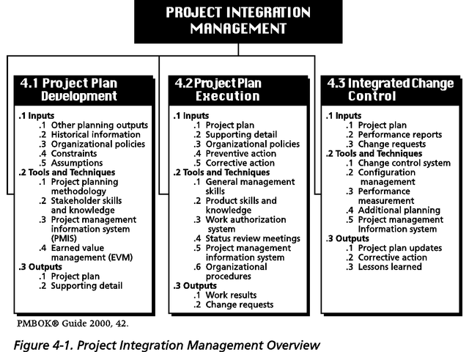
Figure 4-1. Project Integration Management Overview
Note: The PMBOK® Guide 2000 includes similar charts for each knowledge area.

Slide 5
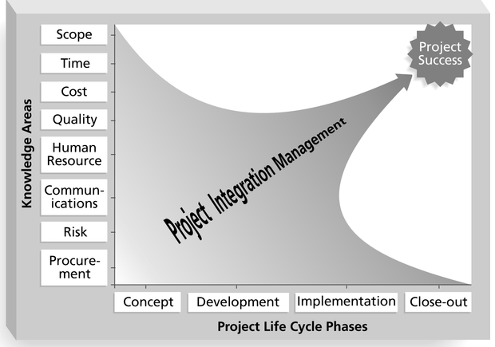
Figure 4-2. Framework for Project Integration Management
Focus on pulling everything to-
gether to reach project success!

Slide 6
Project Plan Development
A project plan is a document used to coordinate all project planning documents
Its main purpose is to guide project execution
Project plans assist the project manager in leading the project team and assessing project status
Project performance should be measured against a baseline plan

Slide 7
Attributes of Project Plans
Just as projects are unique, so are project plans
Plans should be dynamic
Plans should be flexible
Plans should be updated as changes occur
Plans should first and foremost guide project execution

Slide 8
Common Elements of a Project Plan
Introduction or overview of the project
Description of how the project is organized
Management and technical processes used on the project
Work to be done, schedule, and budget information

Slide 9
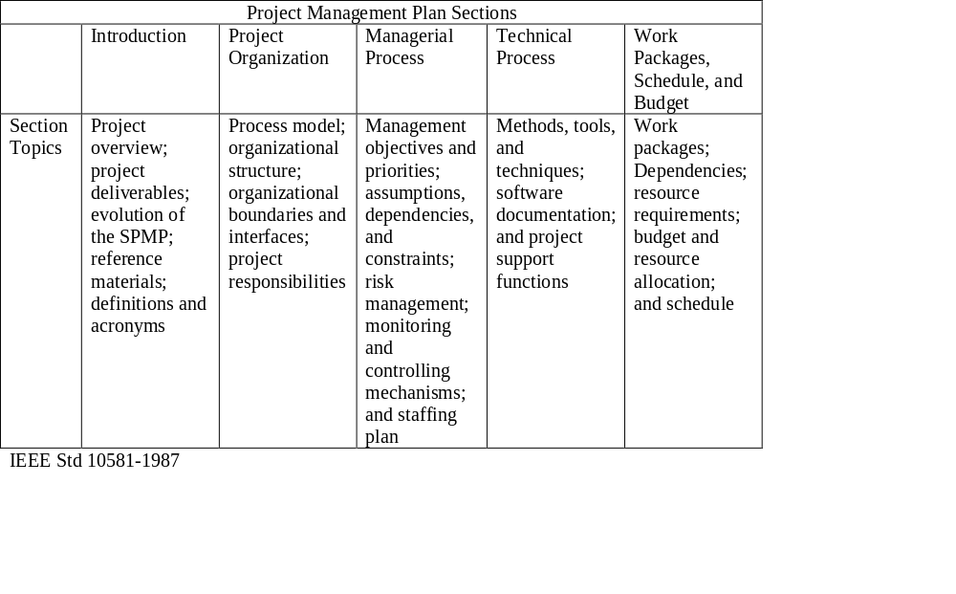
Table 4-1. Sample Outline for a Software Project Management Plan (SPMP)

Slide 10
Stakeholder Analysis
A stakeholder analysis documents important (often sensitive) information about stakeholders such as
  stakeholders’ names and organizations
  roles on the project
  unique facts about stakeholders
  level of influence and interest in the project
  suggestions for managing relationships

Slide 11
Project Plan Execution
Project plan execution involves managing and performing the work described in the project plan
The majority of time and money is usually spent on execution
The application area of the project directly affects project execution because the products of the project are produced during execution

Slide 12
Important Skills for Project Execution
General management skills like leadership, communication, and political skills
Product skills and knowledge
Use of specialized tools and techniques

Slide 13
Tools and Techniques for Project Execution
Work Authorization System: a method for ensuring that qualified people do work at the right time and in the proper sequence
Status Review Meetings: regularly scheduled meetings used to exchange project information
Project Management Software: special software to assist in managing projects

Slide 14
Integrated Change Control
Integrated change control involves identifying, evaluating, and managing changes throughout the project life cycle (Note: 1996 PMBOK called this process “overall change control”)
Three main objectives of change control:
  Influence the factors that create changes to ensure they are beneficial
  Determine that a change has occurred
  Manage actual changes when and as they occur

Slide 15
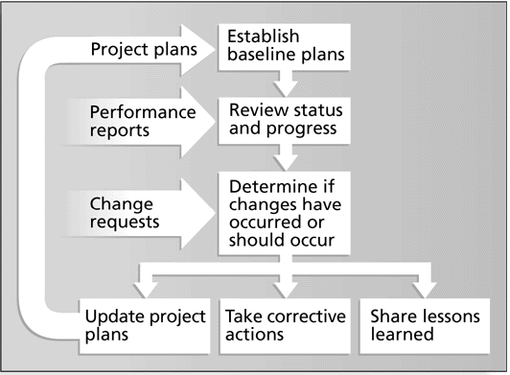
Figure 4-3. Integrated Change Control Process

Slide 16
Change Control on Information Technology Projects
Former view: The project team should strive to do exactly what was planned on time and within budget
Problem: Stakeholders rarely agreed up-front on the project scope, and time and cost estimates were inaccurate
Modern view: Project management is a process of constant communication and negotiation
Solution: Changes are often beneficial, and the project team should plan for them

Slide 17
Change Control System
A formal, documented process that describes when and how official project documents and work may be changed
Describes who is authorized to make changes and how to make them
Often includes a change control board (CCB), configuration management, and a process for communicating changes

Slide 18
Making Timely Changes
Some CCBs only meet occasionally, so it may take too long for changes to occur
Some organizations have policies in place for time-sensitive changes
  “48-hour policy” allows project team members to make decisions, then they have 48 hours to reverse the decision pending senior management approval
  Delegate changes to the lowest level possible, but keep everyone informed of changes

Slide 19
Configuration Management
Ensures that the products and their descriptions are correct and complete
Concentrates on the management of technology by identifying and controlling the functional and physical design characteristics of products
Configuration management specialists identify and document configuration requirements, control changes, record and report changes, and audit the products to verify conformance to requirements

